Slide 1
Course Details
Course Code : CSE3075
Course Name: Mobile Application Development [MAD] Credit Structure: 3 Credits (L=1, P=4, C=3)
Instructor In-Charge: Ms. Ramabai
Mr. R C Ravindranath, Asst. Prof., SOE-CSE, PU

Slide 2
Module 1
Introduction and Architecture of Android

Slide 3
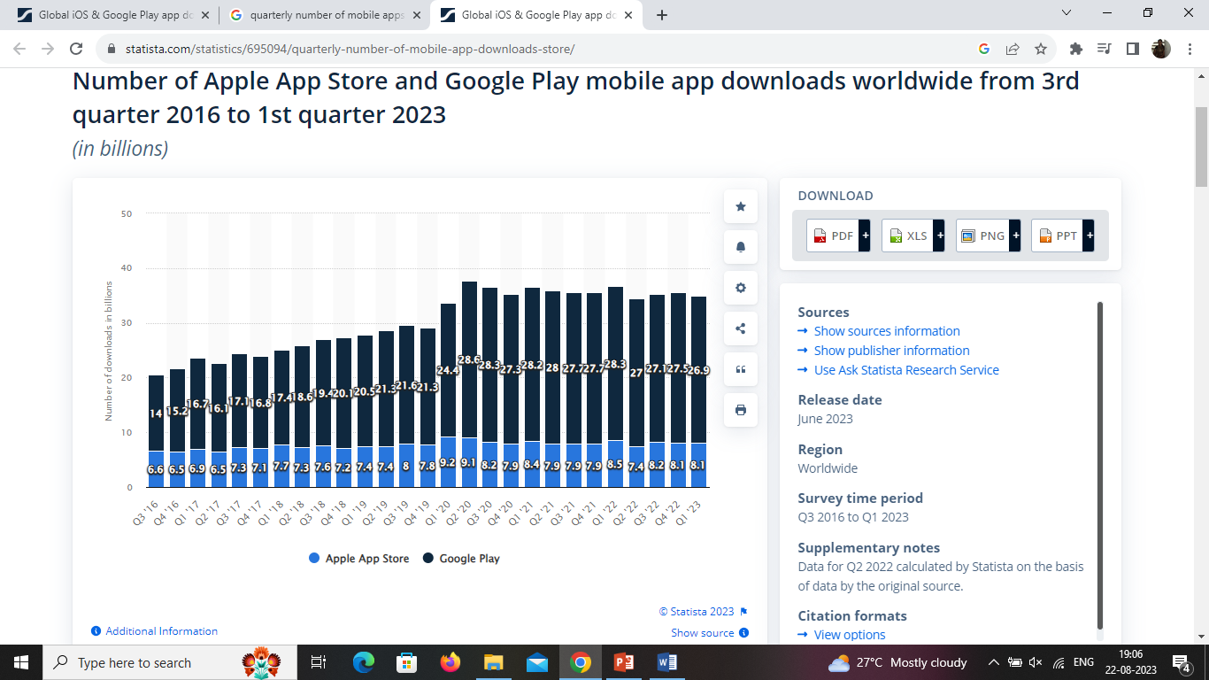
Number of Apple App Store and Google Play mobile app downloads worldwide from 3rd quarter 2016 to 1st quarter 2023. (ref: https://www.statista.com/statistics/695094/quarterly-number-of-mobile-app-downloads-store/)
Why You Should Learn ?
Android key statistics:(ref: https://www.businessofapps.com/data/android-statistics/)
Android has over three billion active users
Three quarters of all smartphones in the world run Android
Over 1.5 billion Android smartphones were shipped last year
Samsung is the largest Android smartphone manufacturer, followed by Xiaomi and Oppo
Mr. R C Ravindranath, Asst. Prof., SOE-CSE, PU

Slide 4
Today's Trends in MAD
Internet of Things (IoT) App Integration
Apps For Foldable Devices
5G Technology
Development For Wearable Devices
Mobile Commerce
Artificial Intelligence (AI)
Mobile Wallets
Augmented reality (aka virtual reality) AR / VR Will Become More Impressive
Predictive Analytics
Superior App Security
Chatbots
Mr. R C Ravindranath, Asst. Prof., SOE-CSE, PU

Slide 5
Challenges of Android app development
Building for a multi-screen world
Getting performance right
Keeping your code and your users secure
Remaining compatible with older platform versions
Understanding the market and the user.
Mr. R C Ravindranath, Asst. Prof., SOE-CSE, PU
Notes:
The Android Developers of today and tomorrow will be responsible for integrating exciting technologies like Artificial Intelligence, Augmented Reality/Virtual Reality, and IoT onto existing applications on the Android OS, creating the new apps for tomorrow that people will use to access information and transact.
Further, as smartphones evolve from entertainment devices to the primary gateway of commercial exchange, creating financial services on mobile platforms is an epoch-changing work in progress with great potential for the years to come.
Finally, as smartphones become the holders of massive reams of personal data, Android developers of the immediate future will have to design security systems to prevent the loss of personal data for millions. The possibilities and potential are truly endless.

Slide 6
Demand for mobile developers:
In India alone, a perusal of job searching platforms like Naukri, Indeed, LinkedIn and Angel List reveal that there are over 20,000 open Android Developer jobs today. Companies are moving more heavily into creating a consummate app experience, driven by projections of smartphone penetration globally.
Nearly all consumer-facing industries have indelibly changed as the smartphone-wielding consumer has become their mainstream target audience.
Mr. R C Ravindranath, Asst. Prof., SOE-CSE, PU

Slide 7
on-demand industry:
Laundry service
Doctors on-demand
Virtual tutors and coaches
Food delivery
House cleaning
Maintenance services
Fitness on-demand
Pet care
Barber and beauty salon
Mr. R C Ravindranath, Asst. Prof., SOE-CSE, PU

Slide 8
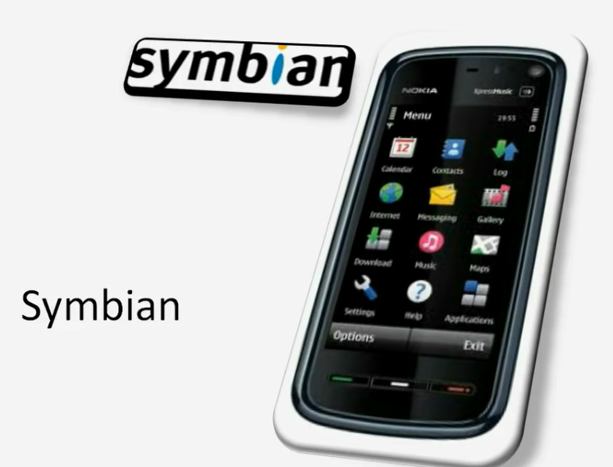
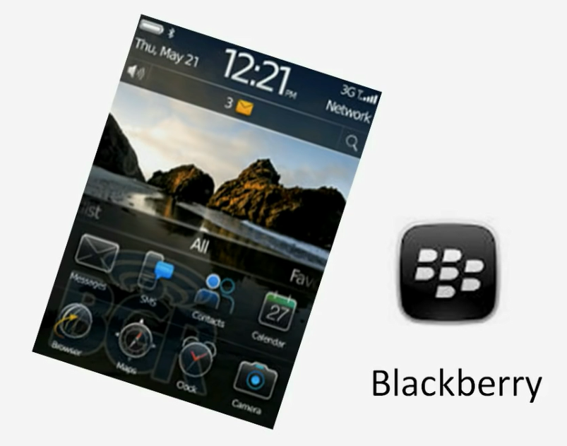
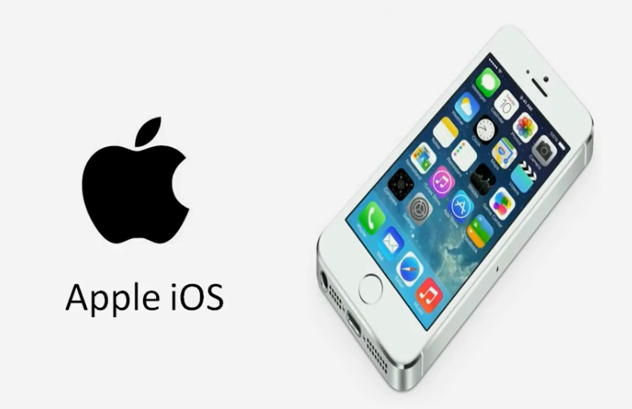
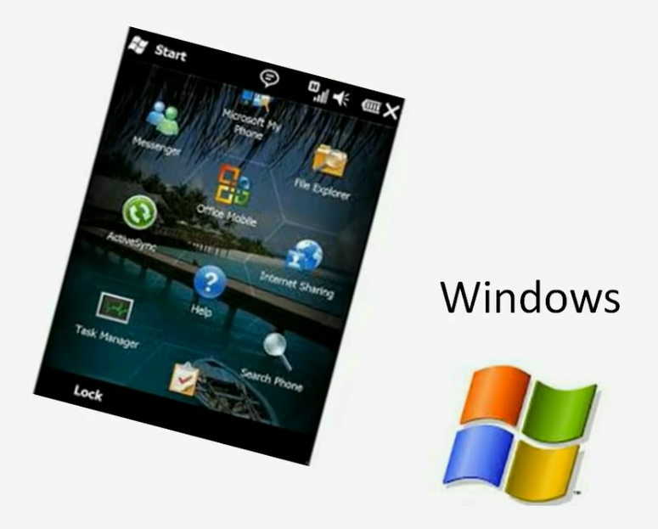
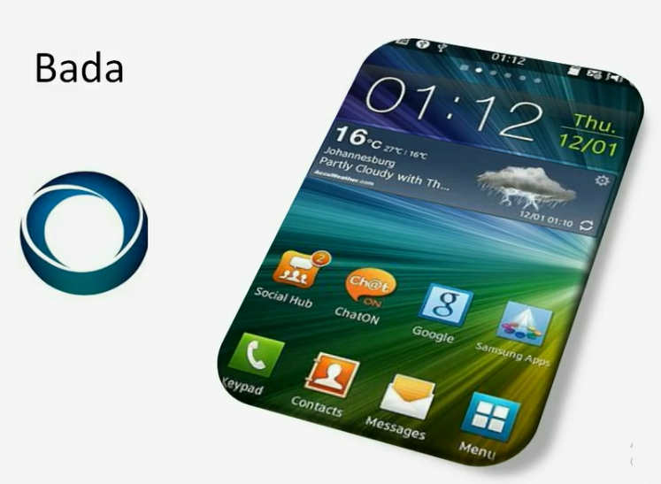
History of Other Mobile OS
Blackberry – 1999 – RIM(Research in Mortion)
Nokia ( C & C++)
MS
Apple IOS
Samsung
Mr. R C Ravindranath, Asst. Prof., SOE-CSE, PU

Slide 9
Android: History
Mobile phone are very common today among people of various age groups.
There are many OS to power the mobile phones, we will focus on Android.
Android is based on Linux family of OSs and written in C,C++ and Java Programming language.
Java lies on the top of its all development layers and therefore its applications are written in Java.
To develop an Android application , Android Software Development Kit (Android SDK) is available with all essential tools (Complier, debugger, device emulator and VM to run Android programs).
Emulator is a virtual device that is used to test or run the application without the availability of hardware.
Mr. R C Ravindranath, Asst. Prof., SOE-CSE, PU

Slide 10
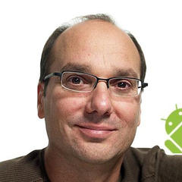
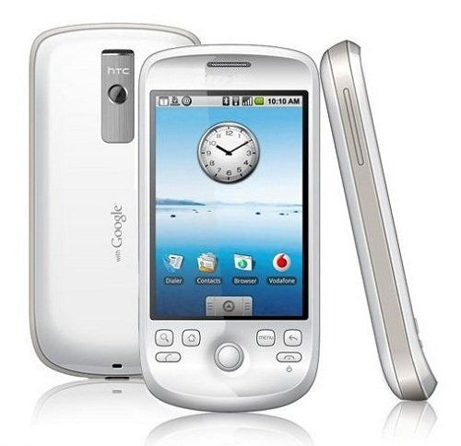
Android: History
Andy Rubin founded Android Incorporation in Palo Alto, California, United States in October, 2003.
In 17th August 2005, Google acquired android Incorporation. Since then, it is in the subsidiary of Google Incorporation.
The key employees of Android Incorporation are Andy Rubin, Rich Miner, Chris White and Nick Sears.
Originally intended for camera but shifted to smart phones later because of low market for camera only.
In 2007, Google announces the development of android OS.
In 2008, HTC launched the first android mobile.
Andy Rubin
HTC Dream
Mr. R C Ravindranath, Asst. Prof., SOE-CSE, PU

Slide 11
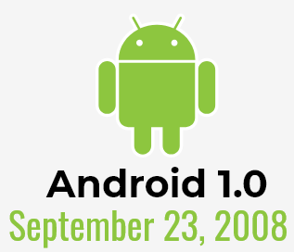
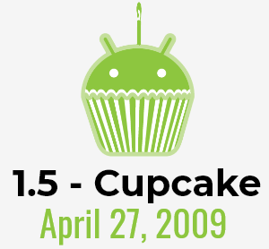

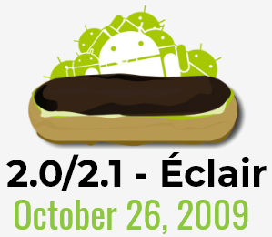

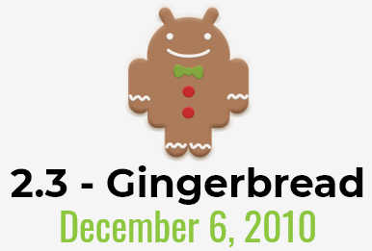

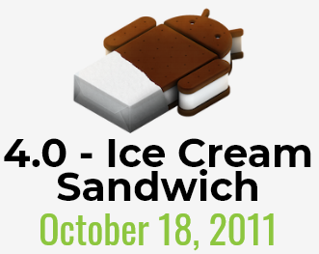
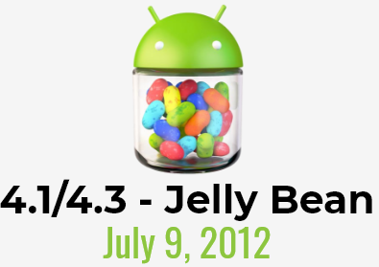
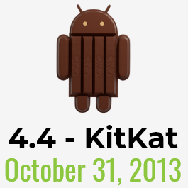
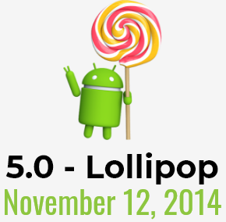
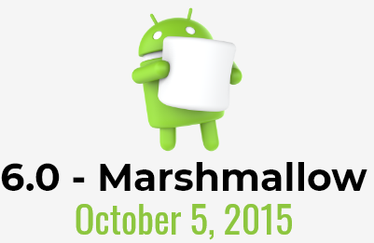
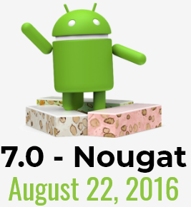
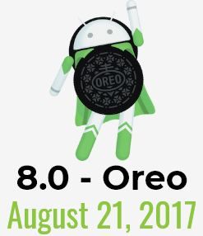
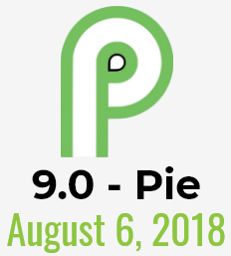
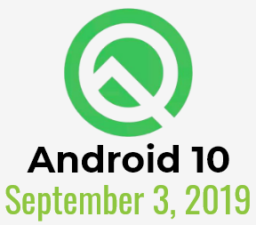
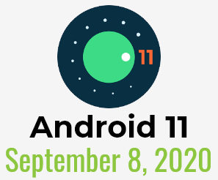
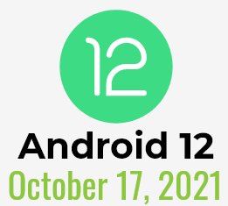


Android: Versions
The code names of android ranges from A to V and Android 15 is currently on progress
Android 13
August 15,2022
Android 14
Q3, 2024
Mr. R C Ravindranath, Asst. Prof., SOE-CSE, PU
Image Ref: https://www.cellphonedeal.com/blog/the-evolution-of-android

Slide 12
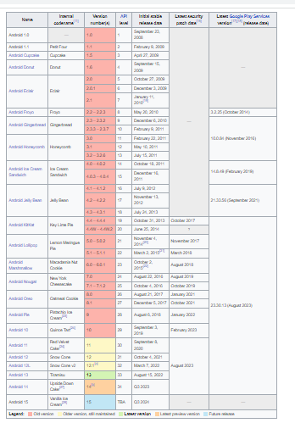
Android: Versions
Mr. R C Ravindranath, Asst. Prof., SOE-CSE, PU
Ref: https://en.wikipedia.org/wiki/Android_version_history

Slide 13
Android: Open Handset Alliance[OHA]
Group of companies, who have come together to accelerate innovation in mobile.
Offer consumers a richer, less expensive, and better mobile experience.
Android™ - the first complete, open, and free mobile platform.
Building a better phone for consumers: Building a better mobile phone would enrich the lives of countless people across the globe.
Innovating in the open: Increased openness will enable everyone in our industry to innovate more rapidly and respond better to consumers’ demands.
Making the vision a reality: commercially deploy handsets and services using the Android Platform.
Members
Mobile Operators
Handset Manufacturers
Semiconductor Companies
Software Companies
Commercialization Companies
Mr. R C Ravindranath, Asst. Prof., SOE-CSE, PU
Ref: https://www.openhandsetalliance.com/oha_members.html

Slide 14
Android: Features
Storage — Uses SQLite, a lightweight relational database, for data storage.
Connectivity — Supports GSM/EDGE, IDEN, CDMA, EV-DO, UMTS, Bluetooth (includes A2DP and AVRCP), Wi-Fi, LTE, and WiMAX.
Messaging — Supports both SMS and MMS.
Web browser — Based on the open source WebKit, together with Chrome’s V8 JavaScript engine
Media support — Includes support for the following media: H.263, H.264 (in 3GP or MP4 container), MPEG-4 SP, AMR, AMR-WB (in 3GP container), AAC, HE-AAC (in MP4 or 3GP container), MP3, MIDI, Ogg Vorbis, WAV, JPEG, PNG, GIF, and BMP.
Mr. R C Ravindranath, Asst. Prof., SOE-CSE, PU

Slide 15
Android: Features
Hardware support — Accelerometer Sensor, Camera, Digital Compass, Proximity Sensor, and GPS
Multi-touch — Supports multi-touch screens
Multi-tasking — Supports multi-tasking applications
Flash support — Android 2.3 supports Flash 10.1.
Tethering — Supports sharing of Internet connections as a wired/wireless hotspot
Mr. R C Ravindranath, Asst. Prof., SOE-CSE, PU

Slide 16
Android: Development Tools
Top Hybrid Mobile App Frameworks
Mobile Angular UI
Appcelerator Titanium
Kendo UI
Sencha Touch
IONIC
PhoneGap (distribution of Apache Cordova)
Apache Cordova (formerly PhoneGap)
Flutter (early-stage funding from Y Combinator & was acquired by Google in October 2013)
Mr. R C Ravindranath, Asst. Prof., SOE-CSE, PU

Slide 17
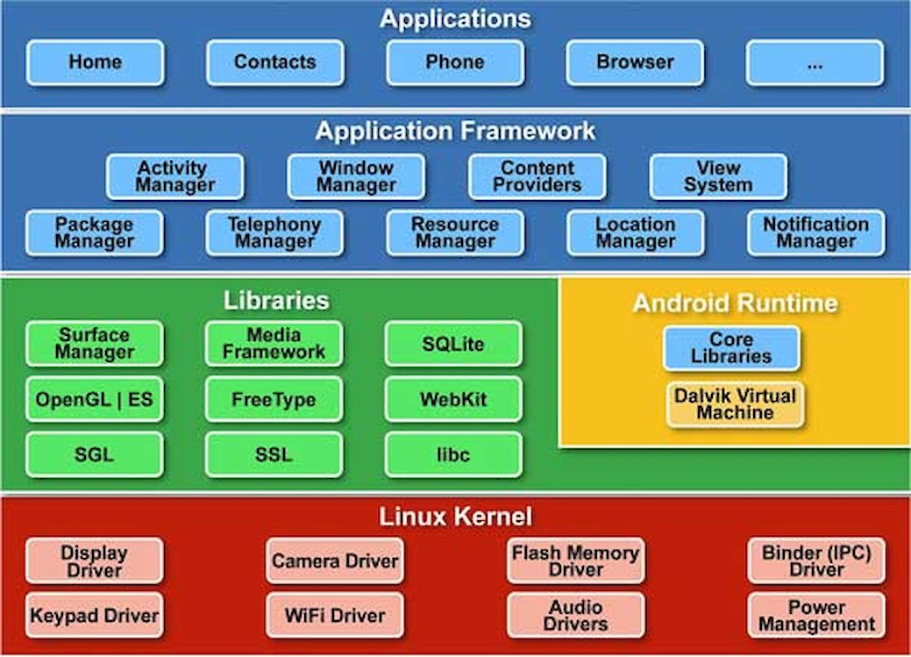
Android: Architecture
1. Linux kernel
It is the heart of android architecture that exists at the root of android architecture.
All the hardware drivers are handled by this kernel.
Drivers are the small programs written specifically to communicate with hardware.
It also serves as the abstraction layer for other layers.
Mr. R C Ravindranath, Asst. Prof., SOE-CSE, PU
Ref: https://source.android.com/docs/core/architecture/kernel

Slide 18
3. Android Runtime
2. Native Libraries
This layer provides the device, which has the capability to handle different types of data and information.
Code in C and C++ languages for fast procedural transactions of data.
Surface Manager, Media Frame work, WebKit, OpenGL, FreeType, Media, C runtime library (libc) etc.
Dalvik Virtual Machine (DVM) which is responsible to run android application.
DVM is like JVM but it is optimized for mobile devices.
It consumes less memory and provides fast performance.
It executes the files with the .dex extension (generated implicitly from the .class file)
Mr. R C Ravindranath, Asst. Prof., SOE-CSE, PU

Slide 19
5. Application
4. Android Framework
The important blocks of Application framework are UI (User Interface), telephony, resources, locations, Content Providers (data) and package managers.
It provides a lot of classes and interfaces for android application development.
It is the top layer in the Android Architecture.
This is the palace where your application is finally deployed over a device.
All applications such as home, contact, settings, games, browsers are using android framework that uses android runtime and libraries.
Android runtime and native libraries are using Linux kernel.
Pre – installed applications can be replaced by newly written applications.
Makes Oss so flexible.
Mr. R C Ravindranath, Asst. Prof., SOE-CSE, PU

Slide 20
1. Activity
Application Components
Activity is a single screen with a user interface
Service performs long-running tasks in background
Broadcast receiver responds to system-wide announcements
Content provider manages shared set of data
An Activity object is similar to a WindowsForm. It usually presents a single graphical visual interface (GUI) which in addition to the displaying/collecting of data, provides some kind of ‘code-behind‘ functionality.
A typical Android application contains one or more Activity objects.
Mr. R C Ravindranath, Asst. Prof., SOE-CSE, PU

Slide 21
1. Activity
Applications must designate one activity as their main task or entry point. That activty is the first to be executed when the app is launched.
An activity may transfer control and data to another activity through an interprocess communication protocol called intents.
For example, a login activity may show a screen to enter user name and password. After clicking a button some authentication process is applied on the data, and before the login activity ends some other activity is called.
2. Services
Services are a special type of activity that do not have a visual user interface. A service object may be active without the user noticing its presence.
Mr. R C Ravindranath, Asst. Prof., SOE-CSE, PU

Slide 22
2. Services
Services are analogous to secondary threads, usually running some kind of background ‘busy-work‘ for an indefinite period of time.
Applications start their own services or connect to services already active.
Examples:
Your background GPS service could be set to quietly run in the backgroud detecting location information from satellites, phone towers or wi-fi routers. The service could periodically broadcast location coordinates to any app listening for that kind of data. An application may opt for binding to the running GPS service and use the data that it supplies.
Mr. R C Ravindranath, Asst. Prof., SOE-CSE, PU

Slide 23
3. Broadcast Receiver
A BroadcastReceiver is a dedicated listener that waits for a triggering system-wide message to do some work. The message could be something like: low-battery, wi-fi connection available, earth-quakes in California, speed-camera nearby.
Broadcast receivers do not display a user interface.
They tipically register with the system by means of a filter acting as a key. When the broadcasted message matches the key the receiver is activated.
A broadcast receiver could respond by either executing a specific activity or use the notification mechanism to request the user‘s attention.
Mr. R C Ravindranath, Asst. Prof., SOE-CSE, PU

Slide 24
4. Content Provider
A content provider is a data-centric service that makes persistent datasets available to any number of applications.
Common global datasets include: contacts, pictures, messages, audio files, emails.
The global datasets are usually stored in a SQLite database (however the developer does not need to be an SQL expert)
The content provider class offers a standard set of parametric methods to enable other applications to retrieve, delete, update, and insert data items.
Mr. R C Ravindranath, Asst. Prof., SOE-CSE, PU

Slide 25
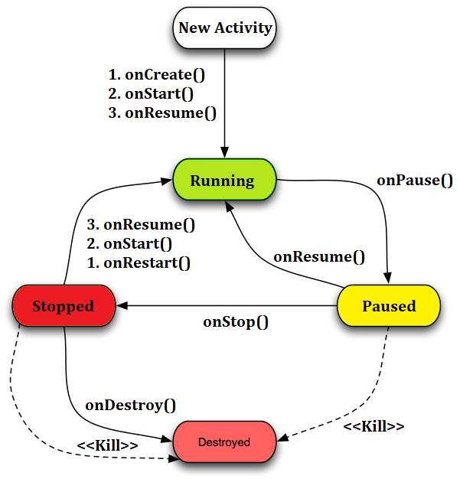
Android: Activity Life cycle
Mr. R C Ravindranath, Asst. Prof., SOE-CSE, PU
Image Ref: https://www.androhub.com/android-activity-lifecycle/
Notes:
Video Ref: https://www.youtube.com/watch?v=UJN3AL4tiqw

Slide 26
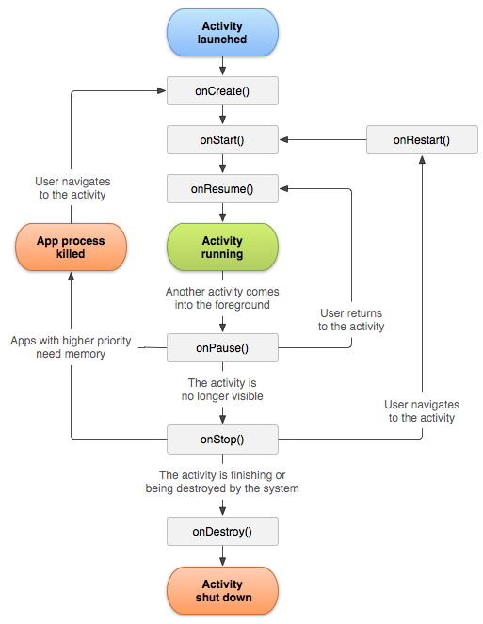
Android Activity Lifecycle methods
Method | Description
onCreate | called when activity is first created.
onStart | called when activity is becoming visible to the user.
onResume | called when activity will start interacting with the user.
onPause | called when activity does not receive user input and cannot execute any code and called when the current activity is being paused and the previous activity is being resumed.
onStop | called when activity is no longer visible to the user.
onRestart | called after your activity is stopped, prior to start.
onDestroy | called before the activity is destroyed by the system.
Image Ref:
https://www.androhub.com/android-activity-lifecycle/
https://developer.android.com/guide/components/activities/activity-lifecycle
Mr. R C Ravindranath, Asst. Prof., SOE-CSE, PU

Slide 27
SDK (software development kit) Manager
The first and most important piece of software you need to download is, of course, the Android
SDK. The Android SDK contains a debugger, libraries, an emulator, documentation, sample code and tutorials.
You can download the Android SDK from http://developer.android.com/sdk/index.html
Android Debug Bridge (ADB)
ADB is a versatile command-line tool that lets you communicate with a device.
The ADB command facilitates a variety of device actions, such as installing and debugging apps, and it provides access to a Unix shell that you can use to run a variety of commands on a device.
Mr. R C Ravindranath, Asst. Prof., SOE-CSE, PU

Slide 28
Android Debug Bridge (ADB)
It is a client-server program that includes three components:
A client, which sends commands. The client runs on your development machine. You can invoke a client from a command-line terminal by issuing an ADB command.
A daemon (ADBD), which runs commands on a device. The daemon runs as a background process on each device.
A server, which manages communication between the client and the daemon. The server runs as a background process on your development machine.
Mr. R C Ravindranath, Asst. Prof., SOE-CSE, PU

Slide 29
END OF MODULE 1
Mr. R C Ravindranath, Asst. Prof., SOE-CSE, PU

Slide 30
Learn more …
Android History
Introduction to Android
Platform Architecture
https://source.android.com/docs/core/architecture
UI Overview
Platform Versions
Supporting Different Platform Versions
Android Studio User’s Guide
Mr. R C Ravindranath, Asst. Prof., SOE-CSE, PU

Slide 31
Thank You
31
Mr. R C Ravindranath, Asst. Prof., SOE-CSE, PU
Notes:
31

